Slide 1
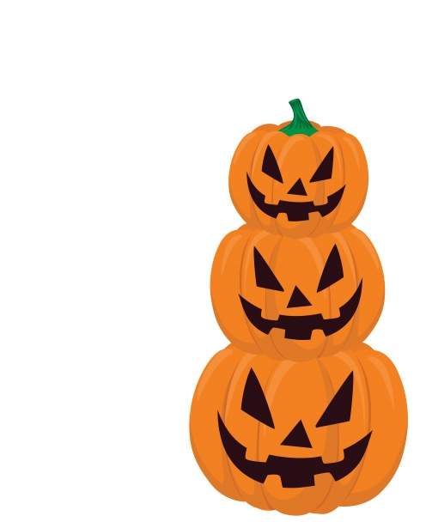
Abingdon Trunk or Treat
Join Abingdon staff for some Trunk or Treat fun on Saturday, October 29! Wear your costume, get some candy, and say hello!
At Abingdon, 12:00 - 2:00
At Infinity Apartments, 12:00 - 12:35
955 S. Columbus St.
At Wildwood Park Apartments, 12:40 - 1:15
Courtyard in back of the building
At Columbia Grove Apartments, 1:20 - 2:00
1012 S. Frederick St.

Slide 2
Abingdon Trunk or Treat
Únase al personal de Abingdon para divertirse con “Trunk or Treat” el sábado 29 de octubre! Vengan con su disfraz, cojan dulces y salúdenos!
At Abingdon, 12:00 - 2:00
At Infinity Apartments, 12:00 - 12:35
955 S. Columbus St.
At Wildwood Park Apartments, 12:40 - 1:15
Courtyard in back of the building
At Columbia Grove Apartments, 1:20 - 2:00
1012 S. Frederick St.

Slide 3
Abingdon Trunk or Treat
በአቢንግደን ትምህርት ቤት ነገ ቅዳሜ መስከረም 29 (October 29) ሀሎዊንን አስመልክተን በምናደርገው የአዝናኝ ቆይታ(Trunk or Treat) ለበአሉ የሚሆን አለባበስ (costume) እንዲሁም ማስክ በመጠቀም እንድትሳተፉ ተጋብዛች፡ኋል።
At Abingdon, 12:00 - 2:00
At Infinity Apartments, 12:00 - 12:35
955 S. Columbus St.
At Wildwood Park Apartments, 12:40 - 1:15
Courtyard in back of the building
At Columbia Grove Apartments, 1:20 - 2:00
1012 S. Frederick St.

Slide 4
Abingdon Trunk or Treat
Авингдон Trunk or Treat
10 сарын 29 ний өдөр, Бямба гаригт Авингдоны ажилтнуудтай хамтран “Trunk or Treat”-д хамт цагийг зугаатай өнгөрөөе!!
Та өөрийнхөө дуртай костюм хувцсаа өмсөж, чихэр авч ирэн бусадтай “ сайн байна уу” гэж мэнд мэдэлцэх болно.
At Abingdon, 12:00 - 2:00
At Infinity Apartments, 12:00 - 12:35
955 S. Columbus St.
At Wildwood Park Apartments, 12:40 - 1:15
Courtyard in back of the building
At Columbia Grove Apartments, 1:20 - 2:00
1012 S. Frederick St.

